Slide 1
Introduction to Network Attacks
INFSCI 1075: Network Security – Spring 2013
Amir Masoumzadeh

Slide 2
Announcements
Homework 1 is due Jan. 29, 11AM
Lab 1 is due Feb. 5, 11AM
  Groups of two (or individual)
  Lab may take up to 2 hours depending on your knowledge of networks
  You can do it on your own machine
  Schedule for the lab will be posted
Typing is appreciated!
  But it is not required as long as your handwriting is readable
I will collect your assignments at the end of the class
If you prefer digital submission send PDF to GSA, CC me
  Subject: IS1075: Homework 1 submission
Do not forget to cite any reference you use (other than the textbooks)

Slide 3
Outline
Attack process
  Reconnaissance
  Exploitation
  Reinforcement
  Consolidation
  Pillage
Classifying attacks & threats
Next lectures:
  Attacks, Exploits, and Vulnerabilities
  Network Defense

Slide 4
Terminology Review
A threat is a potential violation of security
  Violation may not actually occur, but it might occur
  Need to be prepared against threats
  Typical threats - disclosure, deception, disruption, usurpation
An attack is any action that compromises the security of information
  It is an actual violation!
  Can be classified based on information flow, nature of attack, nature of attacker, etc.

Slide 5
Network Attacks
A security breach due to a “standard threat” does not occur instantly.
Computer cracking/hacking is often a long process involving
  Locating a target
  Researching the target
  Penetrating the target
  Exploiting the target
  Covering up
It is rarely as seen in popular media
There are never any fancy “hacker GUIs”

Slide 6
Network Attacks (cont.)
There are also many different types of network attacks
  Attackers may aim to disable a target, gain information from a target, gain control of a target, etc.
  The intent of an attack may range from an “innocent prank” to serious theft and malice
An attack, whether “successful” or “unsuccessful”, may result in serious damage
  e.g., Hardware damage, data loss, reputation damage, IP loss or disclosure, wasted time, etc.

Slide 7
Security Breach as a Process
To effectively detect and defend against intrusions, we must first understand the attack process
  i.e., actions needed to compromise a target
There are many (similar) models of the attack process

Slide 8
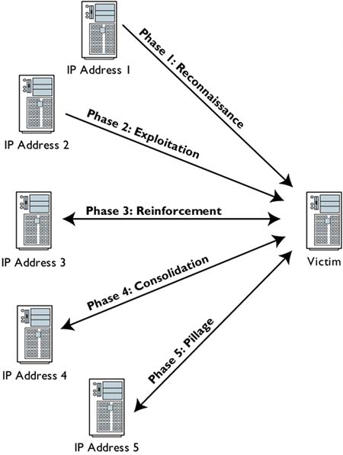
Phases of Attack
Reconnaissance
Exploitation
Reinforcement
Consolidation
Pillage
Reference: The Tao of Network Security Monitoring - Beyond Intrusion Detection

Slide 9
Phase I: Reconnaissance
Attacker confirms a variety of properties of the victim
  Connectivity, services, vulnerable applications
  Network architecture, IP address space, operating systems, versions of software applications
Could be technical or non-technical
Helps the attacker accomplish his objectives in a better way
  Less obtrusive, more efficient, helps planning

Slide 10
Phase I: Reconnaissance (cont.)
Some attacks do not perform reconnaissance
  Commonality of the vulnerabilities
  Increases speed of attack - reduces time to attack
Reconnaissance methods many times appear to be normal
  Make use of commonly available protocols and information services through the information they “leak”
  Social engineering
Defense
  Possible to detect reconnaissance in some cases
    Some probes are not very stealthy

Slide 11
Phase II: Exploitation
Attacker breaches services on the target using every-day protocols
  Mostly through bugs in software tools and in design
Types
  Abuse – illegitimate use of a legitimate mode of access
    use stolen material to illegitimately obtain access
    e.g., remoting into a machine with stolen credentials
  Subversion – causing a service to preform in a way unintended by its designers
    e.g., cross site scripting
  Breach – “break” a service, i.e., stop it, and possinly get its privileges
    e.g., buffer overflows, code exploits, etc.

Slide 12
Phase III: Reinforcement
After exploitation, increase the level of control over victim
  Example - attacker gets user-level access to some services
  Attacker elevates it to administrative or root access
Also introduce tools in the victim hosts that may aid the attacker further
  Perhaps create some backdoors and close the vulnerabilities

Slide 13
Phase IV: Consolidation
Attacker has complete control over the victim host
  Communications are possible covertly through the backdoor
  The victim host may initiate communications with the attacker
Why do attackers use backdoors?
  A more reliable access method
    Machine may crash (especially depending on the exploit)
    Machine may be patched by administrator
    Prevent another attacker from gaining access
    Less likely to attract attention from IDS

Slide 14
Phase V: Pillage
During this stage the attacker has reached the goal and can now
  Steal sensitive info / IP
  Remove / alter data
  Use the target machine for further attack (as zombie)
May be more noticeable to defenders at this point
  Strange behavior
  Further attack
  But not necessary true
    A patient / seasoned attacker will be both careful and crafty

Slide 15
Phases of Attack

Slide 16
Another Model of Attack Process
Slightly different, but essentially the same steps (note the similarities)
Phases
  Reconnaissance
  Scanning
  Gaining access
  Maintaining access
  Covering tracks

Slide 17
Classifying Attacks
Network attacks can be grouped and classified in many ways
  Attacker origin
    e.g., Insider / Outsider
  Level of organization
  Attack dynamics
    e.g., Active / Passive
  Threat vector
    e.g., disclosure, deception, disruption, usurpation
No approved, formal classifications

Slide 18
Attack Origin
Insider and Outsider
  Both insiders and outsiders pose very real potential threats
  Each situation has pros and cons
  An external threat can get insider access

Slide 19
Attack Organization
Structured and Unstructured
  Does the threat have a formal methodology, financial sponsor and defined objective?
    More dangerous, could be long term and subtle
  Threat is one of intellectual curiosity or mindless instantiation of automated code
    Recreational crackers, script kiddies and the like – seeking for notoriety
Motivation
  Human curiosity and fame
  Anti-Establishment
  Economic motivations
  Hacktivism
  Cyberwarfare

Slide 20
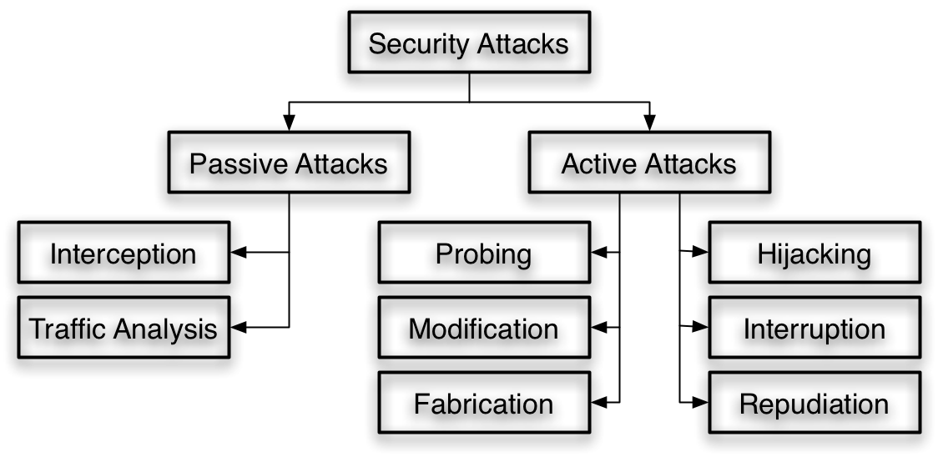
Attack Dynamics
Passive – no active movement against target
  Passive attacks are hard to detect – they should be prevented if possible.
Active – actions are taken to gain information, corrupt, isolate, disable or gain access to a target.
  Active attacks are hard to prevent – they should be detected and responded to as quickly as possible.

Slide 21
Classifying Threats
Disclosure – release of information (private or not)
  Example: traffic sniffing, traffic analysis, information theft, etc.
Deception – forgery of identity and messages
  Message replay, man in the middle, identity theft (system and personal)
Disruption – inhibition of normal operation
  Denial of Service (traffic flood, machine crash, etc.)
Usurpation – unauthorized control of a system
  Privilege escalation, trojans, zombies, etc.
Repudiation – denial of action
  Log removal / editing, etc.

Slide 22
Classifying Threats (cont.)
STRIDE model
  Spoofing identity
  Tampering with data
  Repudiation
  Information disclosure
  Denial of service
  Elevation of privilege

Slide 23
Attacks are sophisticated
Many attacks consists of a series of smaller attacks
  Scenario 1
    An attacker may first passively gain, analyze and sniff traffic
    He/She may use this information to usurp control of a system
    Once he/she has control of the target, he/she may steal information (credit cards, SSNs, etc)
    Then alter the logs to erase the evidence
  Scenario 2
    An attacker may gain access to a machine using a trojan installed on a torrent download
    Once the trojan is active, it advertises itself to the attacker
    The attacker uses the trojan to further compromise the target by installing a zombie software
    The attacker may then use all of the zombies he/she has collected to launch a DoS attack against the real target

